Slide 1


Enterprise Architecture for ALL Stakeholders

Slide 2
Supports all versions of DODAF

Slide 3
DODAF guides and examples are in Envision

Slide 4
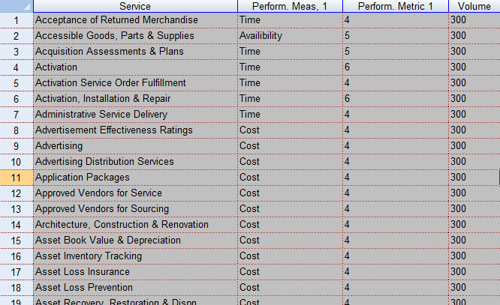
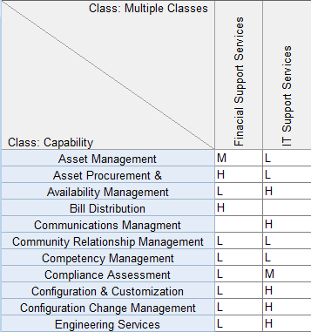
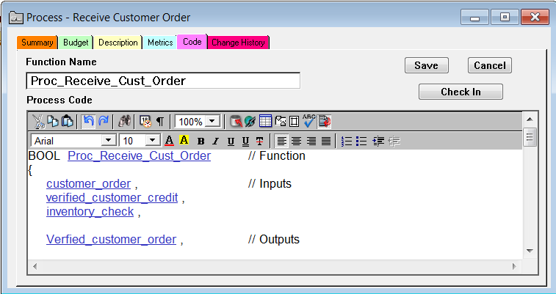
Create and store all Products in Envision

Slide 5
Customized views
for all stakeholders

Slide 6
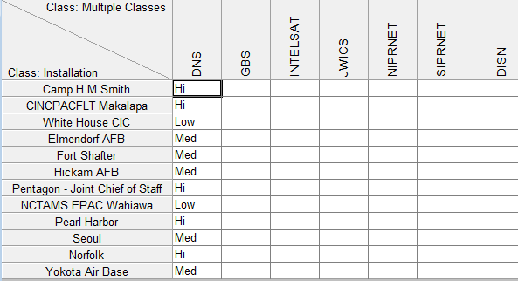
Graphics are linked to underlying data

Slide 7
Easily customize
Envision’s Meta-Models
to use any EA framework
or modeling technique
More than just DODAF

Slide 8
Start creating your customized EA dashboard today!

